Slide 1



Standardization and
Interoperability in healthcare IT
Export HIS Shanghai & Guangzhou seminars
Juha Mykkänen
Health Information Systems R & D Unit
University of Kuopio, Finland
juha.mykkanen@uku.fi
Notes:
Good day, ladies and gentlemen. It is my pleasure to be able to present to you today.
My name is Juha Mykkänen, and I come from the University of Kuopio, Finland, where I work as a research leader in a research and development project dealing with the topics of my talk today:
Interoperability in health information systems and Standardization of healthcare information systems.

Slide 2
In this presentation
Background
Application interoperability – what needs to be solved
Integration: how to create interoperability solutions in health information systems
View on health information systems standardization
International IS standardization
Standardization and Interoperability in healthcare IT - Mykkänen
Notes:
In my presenation, I will briefly describe some problems, solutions and methods to address interoperability and standardization in health information systems. We will look at what the interoperability means for application products, and also see how interoperability solutions can be defined.
We will also look at the standardization of health information systems and discuss the goals and current state of the standardization in this area as well as some requirements to gain the benefits from the standardization.

Slide 3
Background of the presentation
Application integration
  PlugIT project: see Dr. Korpela’s presentation
  Healthcare application integration 2001-2004
  15 software companies, 6 hospital districts, 2 municipalities
  Experiences from 9 integration teams with 13 integration domains in PlugIT
  In this presentation: methods, using which the results were accomplished
  SerAPI project: continues integration and standarization with Service architecture and Web service technologies
Health Information Systems standardization
  national study in Finland: goals, target domains, organization and further actions to improve standardization
Standardization and Interoperability in healthcare IT - Mykkänen
Notes:
In the previous presentation by Mikko Korpela, the main context of this work, PlugIT project, was already introduced. Majority of my material comes from the results and the experiences of that project. The main concrete results of the project included a set of integration solutions, which are now standardized and a set of methods, which are part of this presentation. The interoperability work of the PlugIT project continues in the new SerAPI project, which I am leading. In this project, we are using new service technologies and Web services to enable new solutions for Healthcare Information Systems production, integration and standardization.

Slide 4
Integration Challenges in Health Information Systems
e.g. Kuopio University Hospital has ~180 information systems
point-to-point integration solutions, expensive tailoring, an obstacle for acquisition in health care organizations
integration problems one of the top priorities for software companies (survey in 2001)
simultaneous use of several applications by health professionals to provide care for a single patient (especially in hospitals)
heterogeneity
  legacy systems: even >10 years of use
  applications implemented using several different technologies and platforms
  standardized processes or workflows on few areas, local requirements
several different types of healthcare-specific standards by various standardization bodies
Standardization and Interoperability in healthcare IT - Mykkänen
Notes:
I believe many of us are aware of the great interoperability challenges in healthcare information technology. Especially in large hospitals, there are very many different information systems and applications, which have been implemented during a long period of time using heterogeneous technologies. Currently, these applications do not work together to optimally support the work of the health professionals. There are many different standards available for interoerability, but it is quite difficult to select an optimum set of standards for each product, hospital or integration need.

Slide 5
What is computer interoperability?
Although an intuitive answer is easy, a specific response is more complex
Institute of Electrical and Electronics Engineers (IEEE) dictionary:
"The ability of two or more systems or components to exchange information and to use the information that has been exchanged.”
[IEEE Standard Computer Dictionary: A Compilation of IEEE Standard Computer Glossaries, IEEE, 1990] [Niilo Saranummi, 9 Jan 2002]
Functional
interoperability
Semantic
interoperability
Standardization and Interoperability in healthcare IT - Mykkänen
Notes:
But what does the application interoperability mean? We must be able to exchange information between these different systems. But this is not enough. The exchanged information must be also understood in a common way between the participating systems. Thus, we need both functional and semantic interoperability for any integration solutions to work.

Slide 6
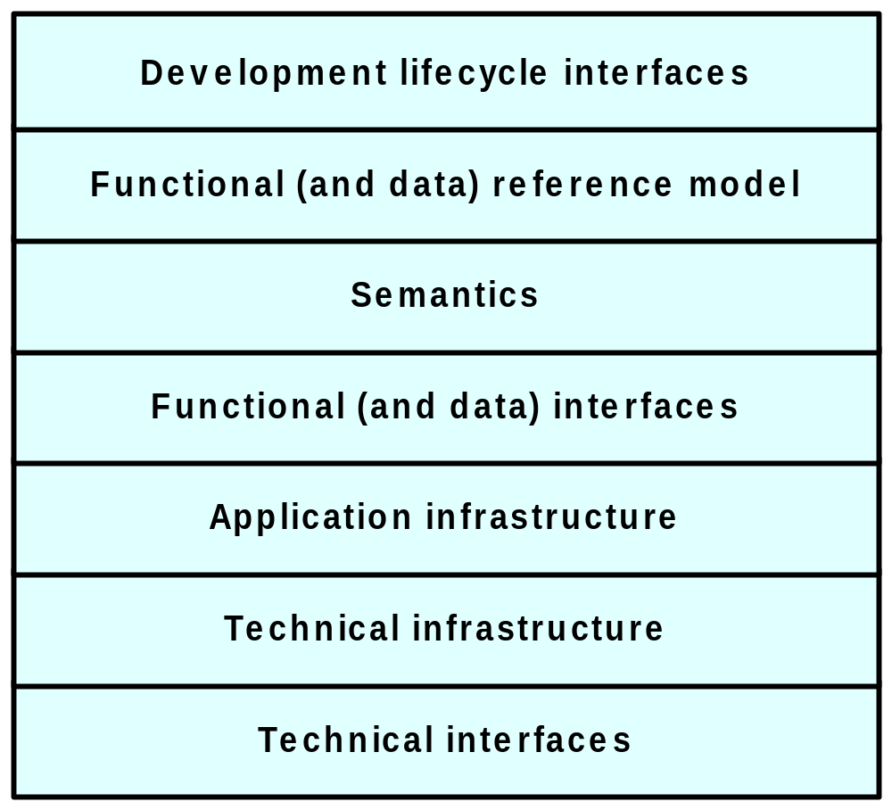
For software applications, interoperability means solutions on many levels
(processes, clinical guidelines, policies…)
When?
systems lifecycle
functional architecture
application architecture
technical architecture
What?
Where?
How?
(networks, platforms, …)
[Herzum, Sims: Business Component Factory. Wiley, 2000.]
Standardization and Interoperability in healthcare IT - Mykkänen
Notes:
Specifically, when we are integrating heterogeneous applications, we must consider many different aspects to achieve interoperability. First, we need to identify WHAT information or functionality needs to shared or integrated. We also need to find the integration points, WHERE the integration solution is connected to the participating systems in their architecture. We need to select HOW, or using which integration models and technologies we can make the solution work, and also sychronize the time, WHEN in a product or hospital project or product lifecycle the integration solutions are made. All these questions need to be solved for any integration solution.

Slide 7
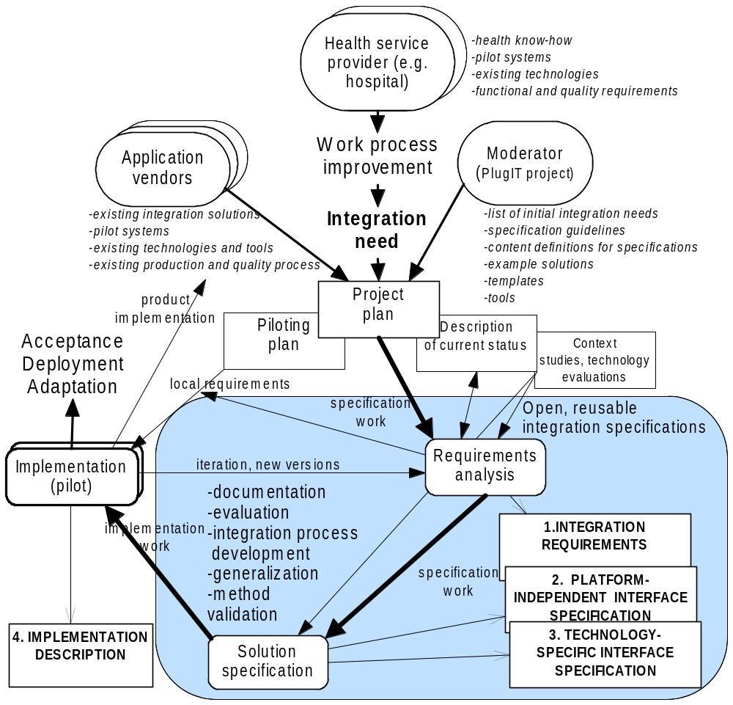
How to specify integration solutions collaboratively
Health service providers,
application vendors and
integrator / moderator
need to collaborate and
gain benefits
Prioritization,
– real needs drive
the solutions
Benefits of
implementation and
introduction
Specification of
open and reusable
integration
solutions
[Mykkänen, Tikkanen, Rannanheimo, Eerola, Korpela. Specification Levels and Collaborative Definition for the Integration of Health Information Systems. Proceedings of Medical Informatics Europe 2003].
Standardization and Interoperability in healthcare IT - Mykkänen
Notes:
In the PlugIT project, we found it necessary to specify interoperability solutions in a collaborative and multidisciplinary way. We also specified a stepwise approach, where more specific definitions are produced from the requirements to the technology-neutral and technology specific solutions and finally to the implementation. All the solutions must be based on the real needs of the users of the applications or the patients. Many solutions can also be reused, if they are generalized in the specification process. Indeed, several integration solutions of the PlugIT project have now been released as open national standards in Finland.

Slide 8
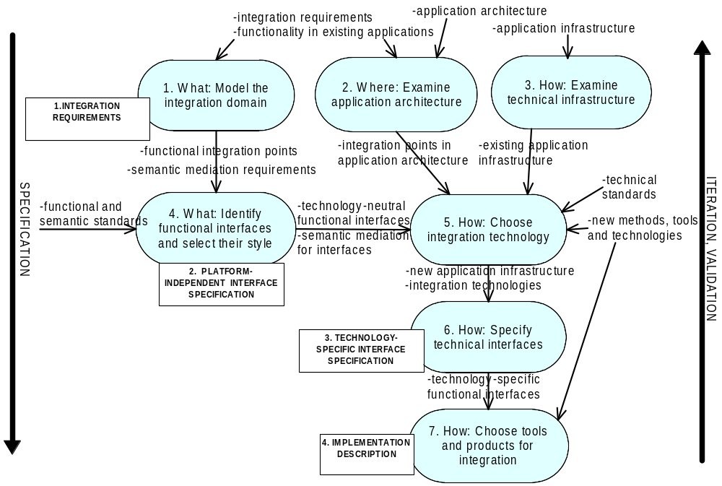
How to define solutions for interoperability
[Mykkänen, Porrasmaa, Korpela: A process for specifying integration for multi-tier applications in healthcare. Int J Med Inf 2003:70(2-3):173-182.]
Standardization and Interoperability in healthcare IT - Mykkänen
Notes:
As part of the integration specification, the documentation of the integration requirements is the basis for all the design decisions. The existing applications to be integrated must be studied on many levels: functionality, architecture and technology levels. This helps us to utilize the existing solutions and know-how in the organizations, which speeds up the process and increases success probability. New healthcare-specific and technology standards are also often needed in the process, but they must be evaluated carefully. Activities of this process produce a set of reusable integration specifications, which are used in the implementation and acquisition of the applications.

Slide 9
Standardization of health information systems
Aims of standardization
  uniformity, compatibility, objectivity, justice, hegemony
Target areas
  healthcare information, processes and knowledge
  healthcare IT solutions (messages, interfaces, security solutions, architecture, support for information and processes)
Standard families (e.g.)
  HL7 Standards (messaging, version 3, clinical documents, clinical context integration, knowledge presentation)
  CEN and national standards (national healthcare records, contents, guidelines, security, architecture)
  move towards official ISO standards
Standardization and Interoperability in healthcare IT - Mykkänen
Notes:
As I mentioned, we need to evaluate standards in integration solutions. But we can also aim to produce standards or participate in their production, if we aim to unify systems or make them compatible. Standards can also be used to unify markets, make them open or equitable, to produce objective and justifiable assessment of systems, or to gain leadership on some application area. In relation to health information systems, healthcare expertise is needed in specifying the information content and functionality or links to practice from the standards. But also combination of healthcare know-how and technical expertise is needed in healthcare IT standards. There are many different standards available, and some standards organizations have lately been working together, but it is still quite difficult to identify right standards or to evaluate all the effects of a given standard, to which we have also developed methods.

Slide 10
Current status and lessons from standardization in Finland
Current emphasis on electronic patient records with support for semantic interoperability
  content, structure, codification
Other current standardization areas
  usability (e.g. context management)
  common services (service interfaces, service architecture)
  security
Localization needed in content and coding
Each new messaging standard has been ”more strict” than the previous one
Standardization and Interoperability in healthcare IT - Mykkänen
Notes:
Currently, the emphasis in health information system standardization in Finland is in electronic patient record, as we heard in Dr. Korpela’s presentation. HL7 CDA standards are applied for this purpose. However, to support the electronic patient record and the applications, there are also national and international activities in clinical context management, shared services between applications and Public Key Infrastructure security standards. However, many if not all of the standards need localization measures or local application guides, because of national specifics in healthcare models, required information sets or user terminologies and codesets. In the evolution of the standards we can also see that there has always been a need to define interfaces between applications in a more restricted way, to reduce expensive local or product-specific tailoring work.

Slide 11
To make standardization work
We need to carefully evaluate and select existing standards
  and support their implementation in local practices
Make use of domain-independent reference standards and common technology standards
  e.g. XML-based, security, framework and semantic standards
Specify ownership for standardization
  and different standardization areas
Collaborate on inter-professional and international levels
  and assure quality and adequate participation of experts on different disciplines
Standardization and Interoperability in healthcare IT - Mykkänen
Notes:
The existing healthcare information system standards are not compatible, even within one standardization organization. Thus, we need to evaluate them carefully. Standards become successful only when they are used widely. Thus, we need to select and support the use of main standards firmly. The new technologies provide new and more powerful interoperability possibilities for the systems, and we must be able to make use of them in healthcare-specific solutions. An example of this is a web services technology family, which provides great possibilities for interconnected systems. For different needs, different standards are needed: for example messaging, usability and security needs require different types of standards. As the healthcare IT is a inter-disciplinary field, also the standardization must be collaboration between experts on different professions, and we need to define a common language and understanding of these experts who have their own languages and views to succeed in standardization or interoperability solution development.

Slide 12
Thank you
www.centek.fi/serapi
www.plugit.fi
www.uku.fi/tike/his/english
Questions and further discussions welcome
Tekes grant no. 40437/04 (SerAPI, 2004­2005): www.centek.fi/serapi
National Technology Agency Tekes grants no. 40664/01, 40246/02 and 90/03 (PlugIT, 2001­2004): www.plugit.fi
Juha.Mykkanen@uku.fi
Standardization and Interoperability in healthcare IT - Mykkänen
Notes:
I will conclude my presentation here, I hope you have received also some new ideas about the interoperability and standardization of healthcare information systems. I would like to thank our local hosts and all of you for participating, and I am willing to continue discussion and collaboration with you now or at a later time. Feel free to ask any questions now or contact me further. Thank you.

